Slide 1
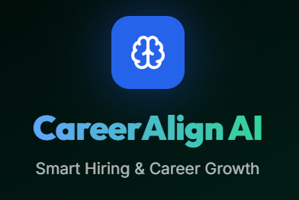

CAREER ALIGN AI
Team B
G. Krishna Sree
Likhitha Devarasetty
Lokeshwari Cheeraboyina
Gnanendhiran V
Kuruba Hemanth Kishore
MENTOR
Slide
1
Sangeetha Mam

Slide 2



Introduction
CareerAlign AI is an end-to-end career intelligence platform that uses AI to analyze resumes, assess skills, predict job roles, and highlight improvement opportunities. For recruiters, it provides smart candidate comparison, ATS scoring, and streamlined decision-making—redefining how talent is discovered and evaluated.
Slide
2

Slide 3

Key Features
Resume Upload & PDF Parsing - Extract text from PDF resumes
AI Resume Analysis - Automatic skill extraction and evaluation
ATS Score Calculation - Measure resume quality for job applications
Job Description Matching - Compare skills against job requirements
Skill Gap Analysis - Identify missing skills and recommend learning paths
Job Role Prediction - Suggest suitable career paths based on skills
Candidate Comparison (HR) - Side-by-side candidate evaluation
Slide
3

Slide 4

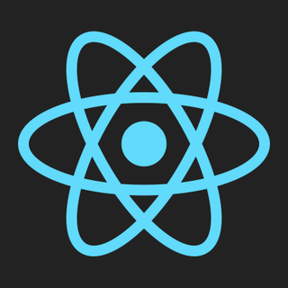

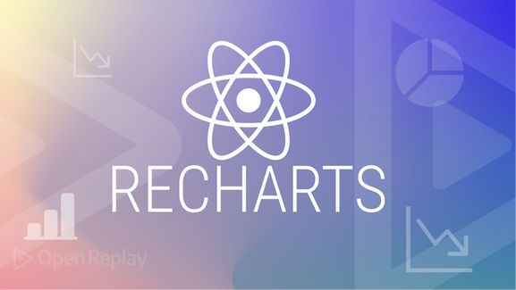
Frontend Technologies
Slide
4

Slide 5

Backend Technologies
Slide
5

Slide 6
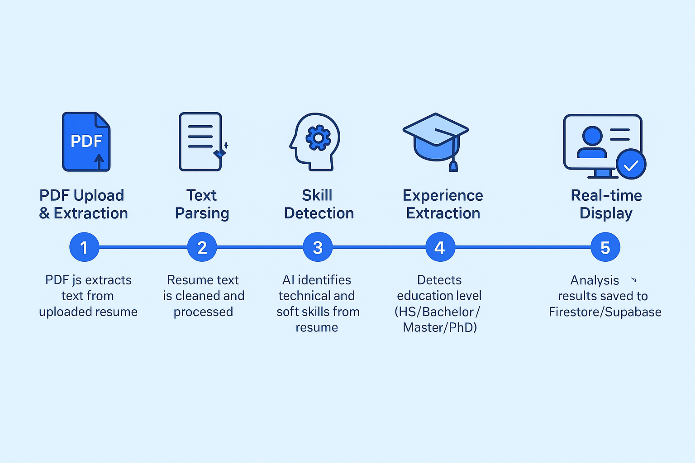
Analysis Process
Slide
6

Slide 7


Skill Matching and Recomendation
Semantic Similarity Using Embeddings
• Uses Xenova/all-MiniLM-L6-v2 transformer model
• Converts skills into vector embeddings
• Calculates cosine similarity between skills
Skill Matching Strategy:
• Exact matches (skill = skill)
• Semantic matches (similar skill embeddings > 0.65 threshold)
• Prevents false positives and improves accuracy
Slide
7

Slide 8



Job Role Prediction System
Automatic Role Suggestion based on extracted skills:
• Frontend Developer - React, Angular, Vue, HTML, CSS detected
• Backend Developer - Node.js, Python, Java, SQL, MongoDB detected
• Full Stack Developer - Both front & back-end skills present
• DevOps Engineer - AWS, Docker, Kubernetes, CI/CD tools found
• Data Scientist - Python, ML libraries, statistics detected
• And more roles based on skill combinations
Slide
8

Slide 9
Candidate Dashboard Features
Upload & Manage Resumes - Multiple resume uploads
Job Role Selection - Choose target job roles for analysis
Job Description Input - Paste job descriptions for matching
Match Score Display - See overall job fit percentage
Skills Breakdown - Matching, missing, and extra skills visualization
Learning Recommendations - Personalized course suggestions from platforms
Project Suggestions - Build portfolio projects to fill skill gaps
Export to PDF - Download analysis reports
Slide
9

Slide 10
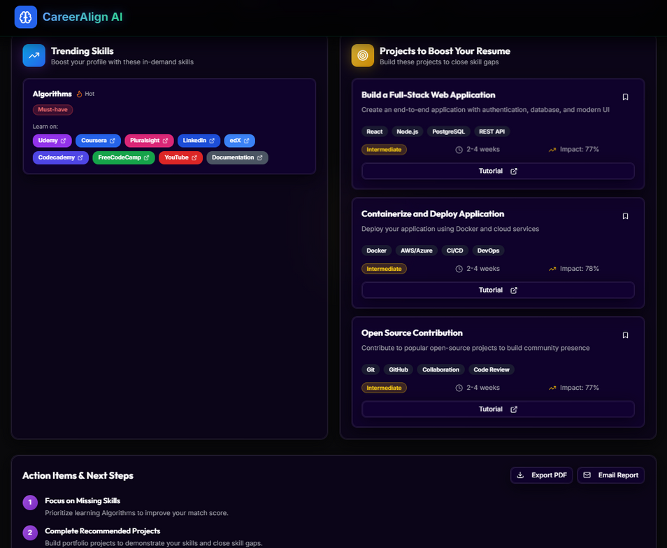
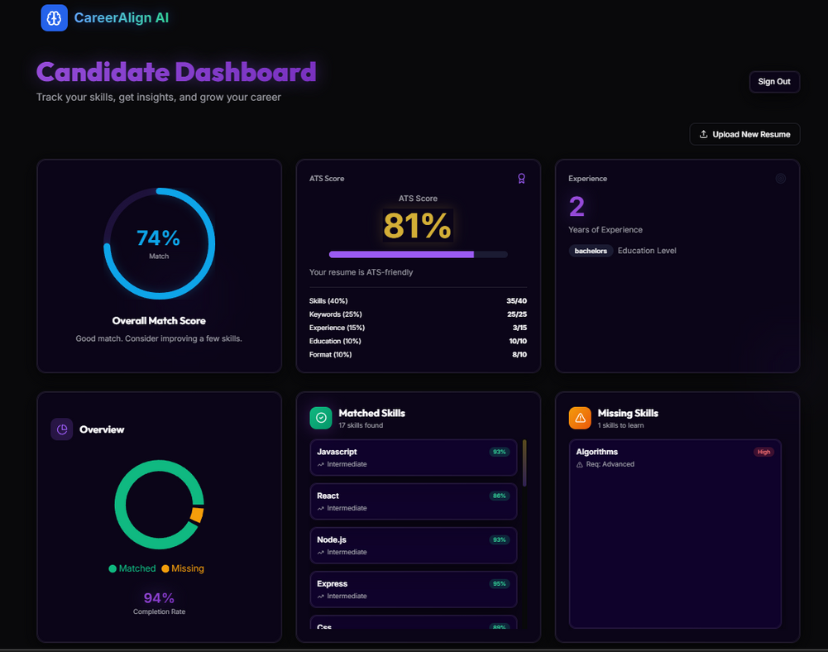
Candidate Dashboard
Slide
10

Slide 11
HR Dashboard Features
Bulk Upload Resumes - Upload resumes of multiple candidates with ease
Job Description Upload - Paste the job description
Avg Match Score - Displays the average match score
Candidate Comparison - Evaluation of multiple candidates
ATS Score Ranking - Sort candidates by match score
Analytics Dashboard - View candidate statistics and trends
Candidate Selection - Mark top performers for interviews
Slide
11

Slide 12
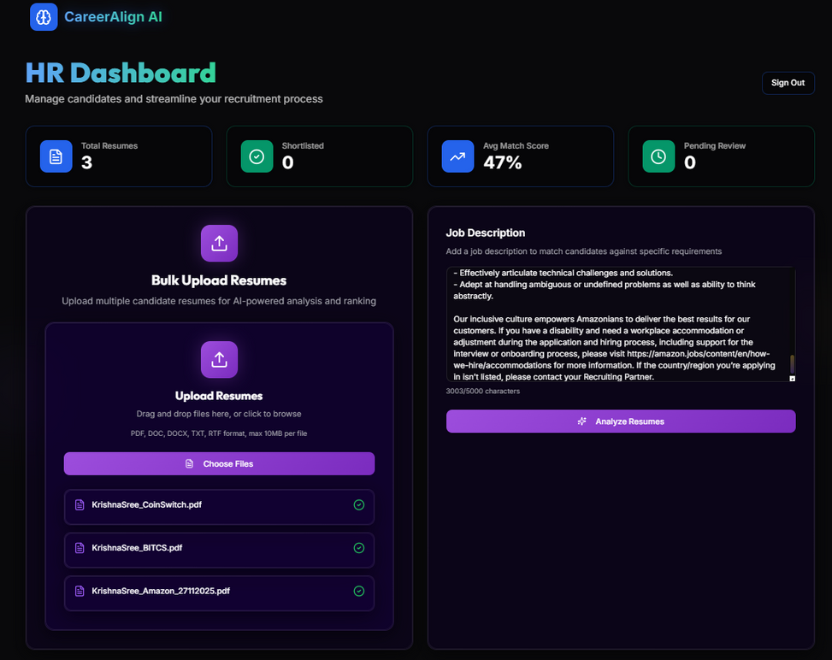
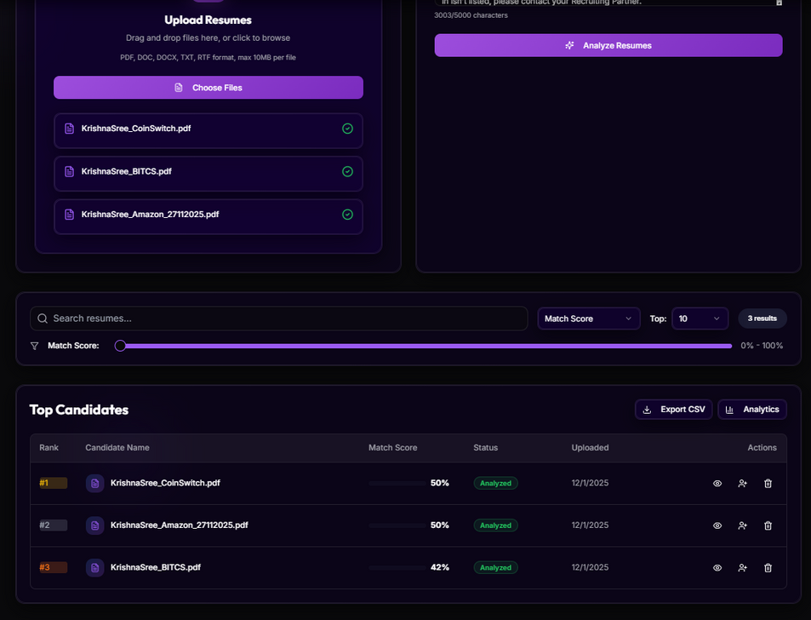
HR Dashboard
Slide
12

Slide 13
Conclusion
CareerAlign AI delivers a comprehensive, AI-driven platform that enhances recruitment and career development through advanced resume parsing, skill matching, and robust analytics. Its dual-role support and cutting-edge technology stack provide scalable, efficient solutions, positioning it as a pivotal tool for the future of smart hiring and talent growth.
Slide
13

Slide 14

THANK YOU
FOR YOUR ATTENTION
Slide
14

